Slide 1
Intro to Crafting Packets with Scapy
Anthony Critelli

Slide 2
What is Scapy?
Tool for reading and writing packets
Sniff on the wire, decode, rewrite, create from scratch, and more!
Written by Philippe Biondi
http://www.secdev.org/projects/scapy/
Can be used from standalone console or from within your own Python scripts
Python 2.4 or greater

Slide 3
What can you use it for?

Slide 4
Test your network applications!

Slide 5
Replace other tools!
Notes:
Here we can see Scapy performing the functionality of a packet sniffer. It can also perform the functionality of tools like arpspoof and nmap. While you’ll probably still choose to use these tools because of their rich feature set, Scapy is capable of performing well in a pinch.

Slide 6
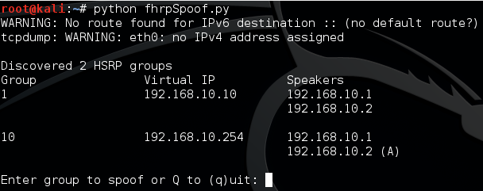
Build your own tools!
Notes:
Let Scapy handle the heavy lifting of lower layer manipulation.

Slide 7
Some important Scapy commands
ls() – show available scapy protocols
lsc() – show available scapy functions
show() – display packet field information and values
send() – send packets at Layer 3
sendp() – send packets at Layer 2
sr() – send packets and receive response
sr1() – send packets and receive only 1 response

Slide 8
So, how do we do it?

Slide 9
We’ll do it live!
Notes:
Live demo to include simple ping and then an HSRP spoofing example.

Slide 10
Other resources
http://www.secdev.org/projects/scapy/
http://thepacketgeek.com/series/building-network-tools-with-scapy/
http://packetlife.net/media/library/36/scapy.pdf
Notes:
Secdev.org is the official page for the project
Thepacketgeek.com has an awesome tutorial on getting started with Scapy. This includes navigating the tool, as well as building your own applications in Python.
Packetlife.net has an awesome Scapy cheat sheet. Thanks, Stretch!

Slide 11
Questions? Comments?
www.acritelli.com
critellia@gmail.com
@acritelli

